Slide 1
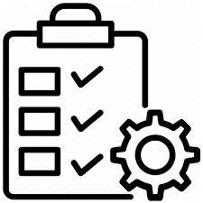
Order Management App
MADE BY-
Prajjwal Pandey

Slide 2
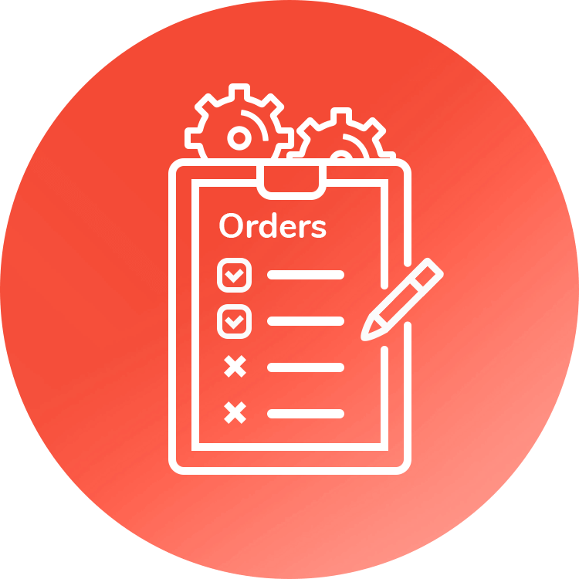
Abstract:
The Order Management App is to save the time by making the process of order creation, products and invoice management easy for the user. It allows the users to create order with user friendly User Interface. After creating the order they are able to add products to that order, they can add the quantity and discount given on the products. After Order Creation users are allowed to create invoices based on the approved order, and notification would be sent to the associated people about the order status automatically. It also allows the manager of sales users to view the whole data in a simplified and attractive way.

Slide 3
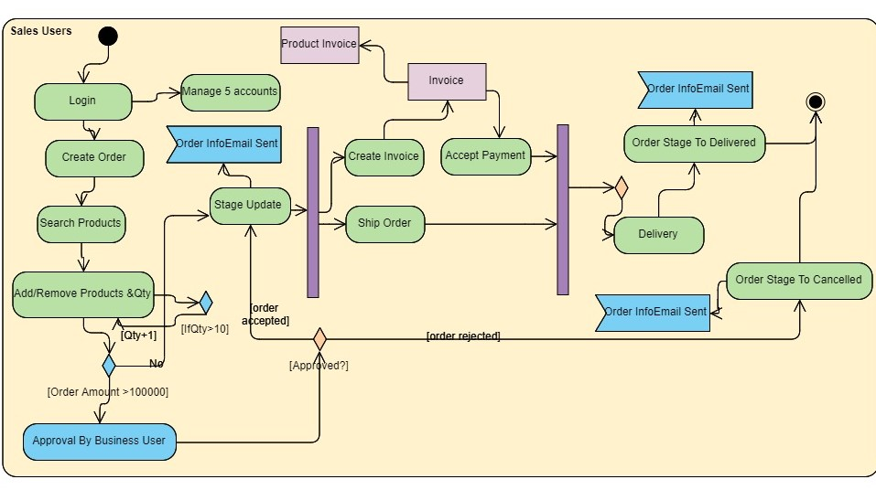
Activity Diagram
[confirmProducts]

Slide 4

DEVELOPER PART

Slide 5

Triggers

Slide 6
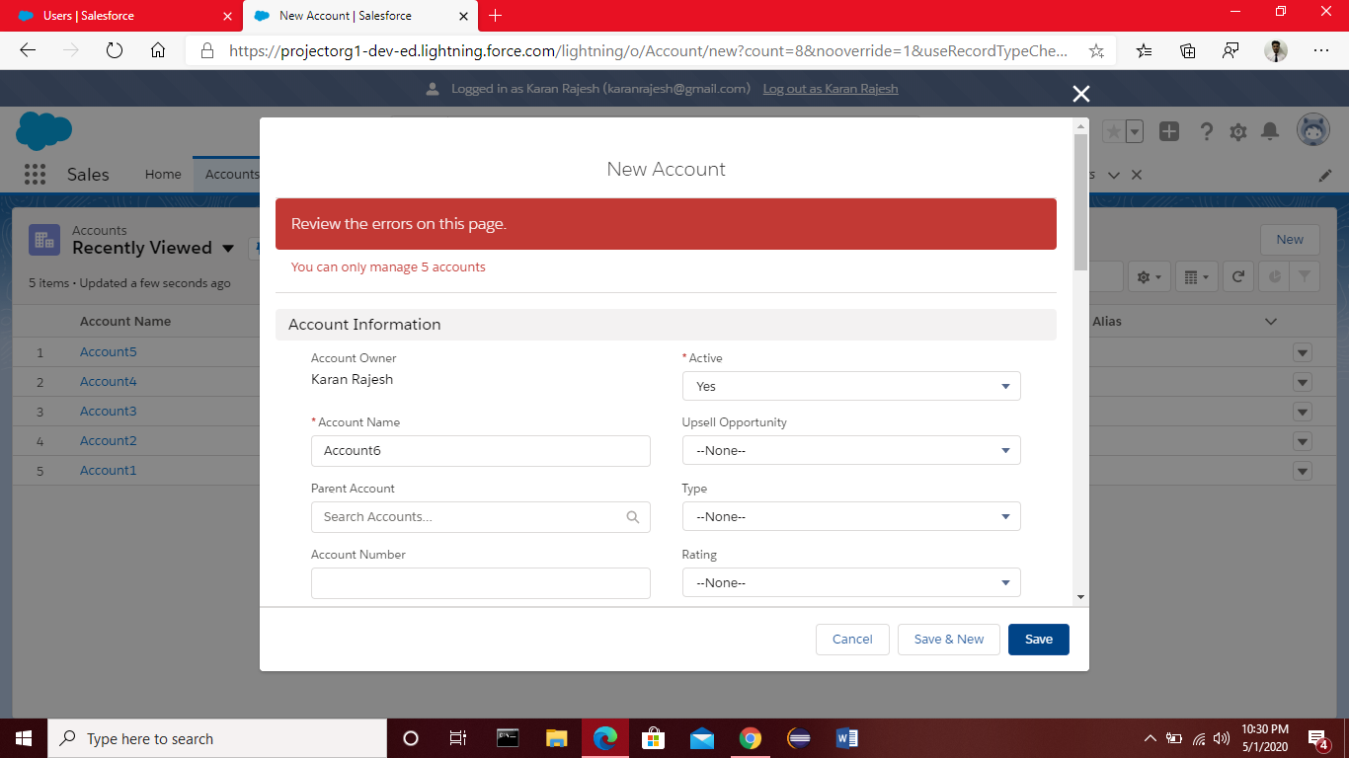
1.To allow Sales User to manage at most 5 accounts.
Done with the help of trigger on account and using before insert and before update triggers. Getting all the accounts in a list and if the size of the list greater than 5 add error.

Slide 7

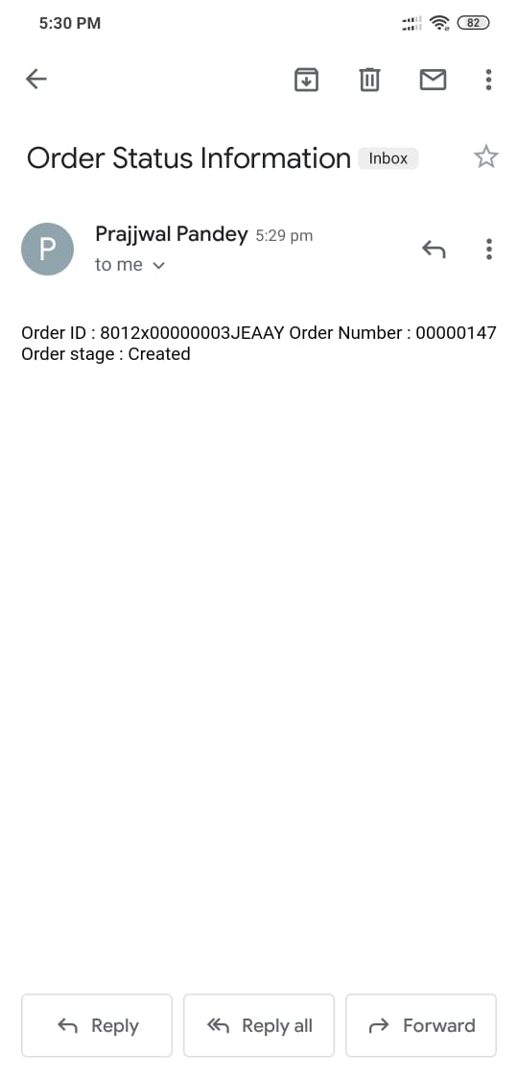
2.Email to those contact
With email opt out field True
Getting list of accounts and contacts list of related account and sending message on stage change with the help of SingleEmailMessage

Slide 8
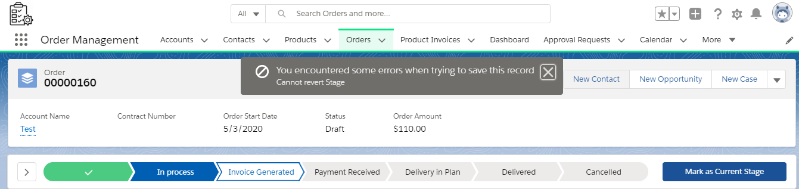
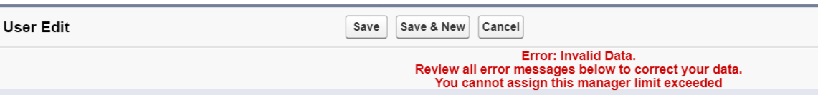
3.Stage can’t go back to previous state
Trigger on order when there is change in stage.
4.One Business User can manage at most 2 sales user
Trigger on User checking
Manager Id Size.

Slide 9

LWC & Aura

Slide 10
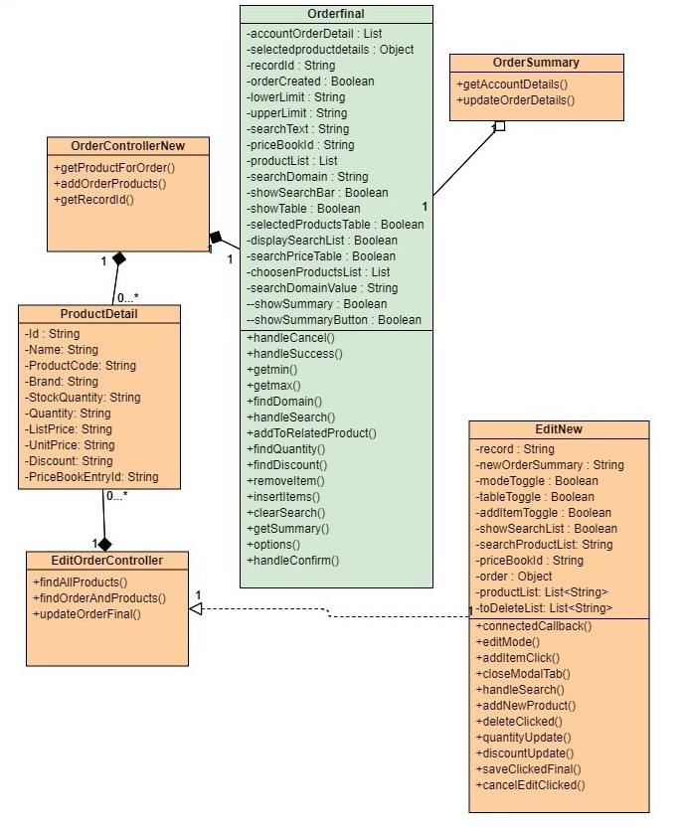
Class
Diagram
Class Diagram

Slide 11
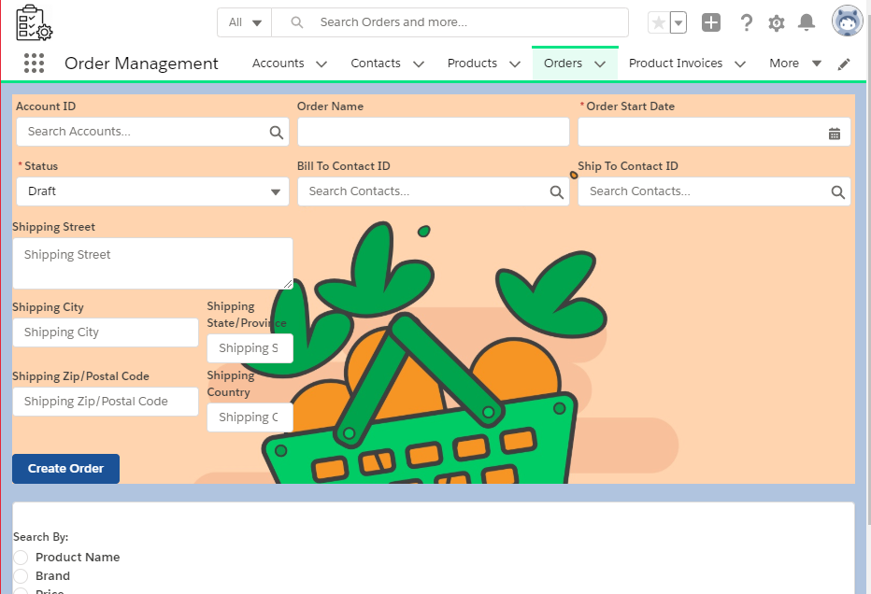
Order Creation Page

Slide 12
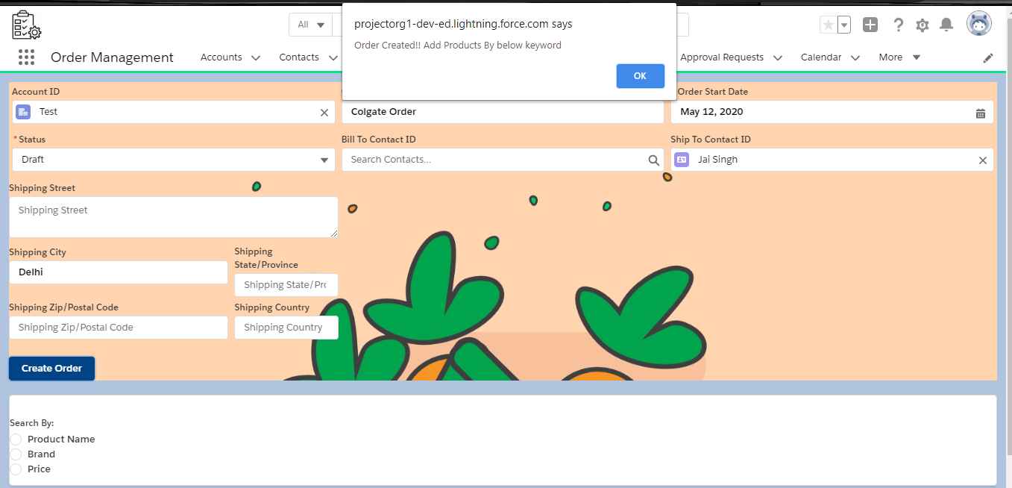
Fill Details & Click Create Order

Slide 13
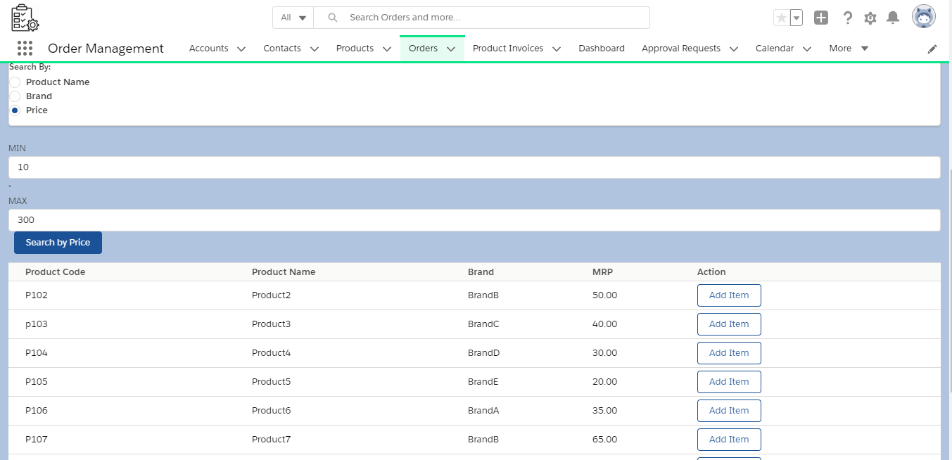
Search By Price

Slide 14
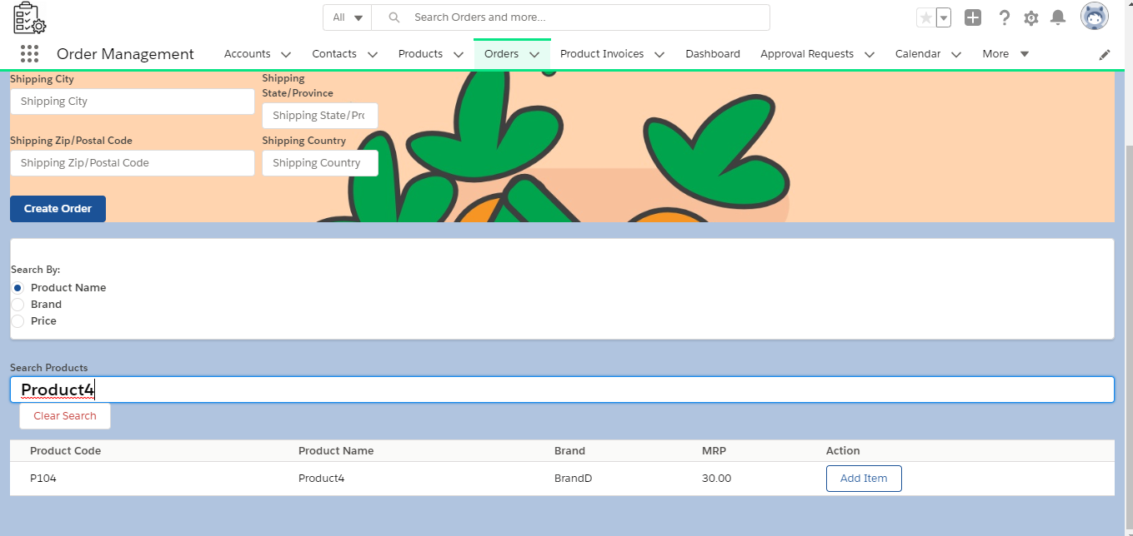
Search By Product Or Brand

Slide 15
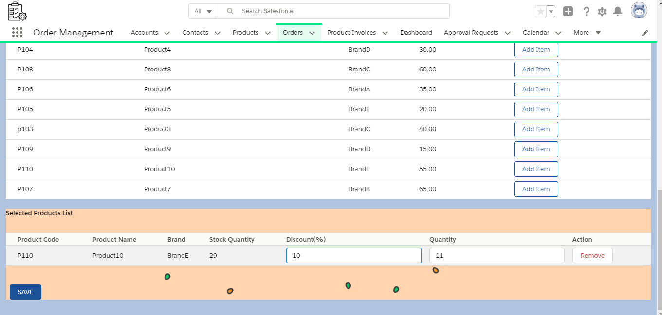
Select Items, then Add Quantity &
Discounts, Click “SAVE”

Slide 16
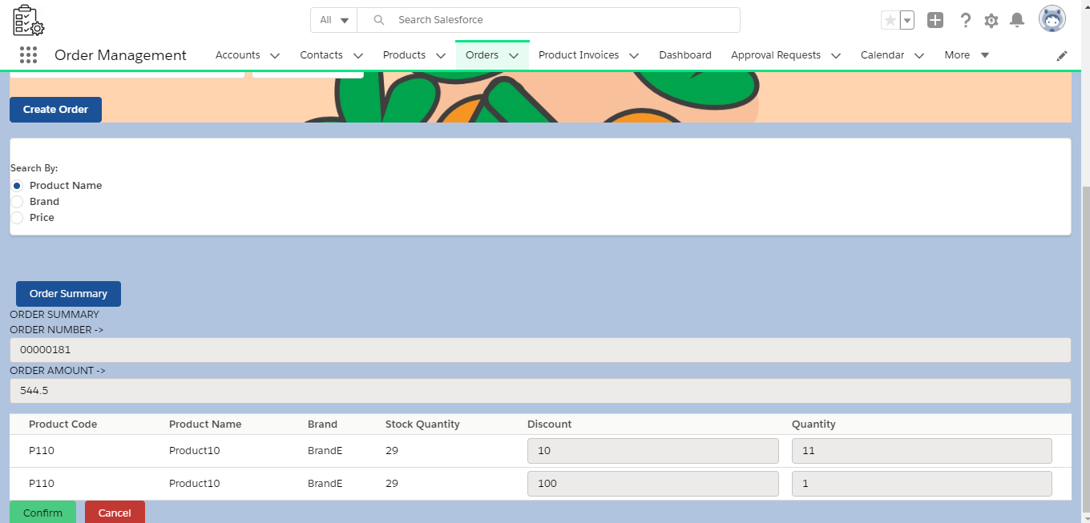
Click Confirm And Products are added

Slide 17
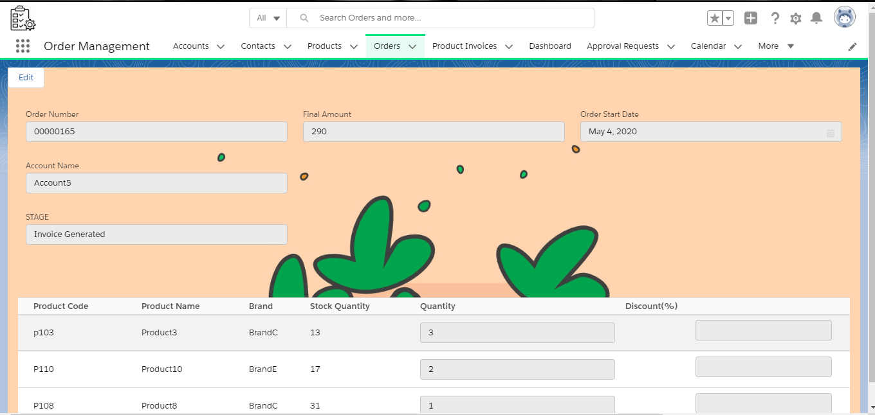
View Order Page

Slide 18
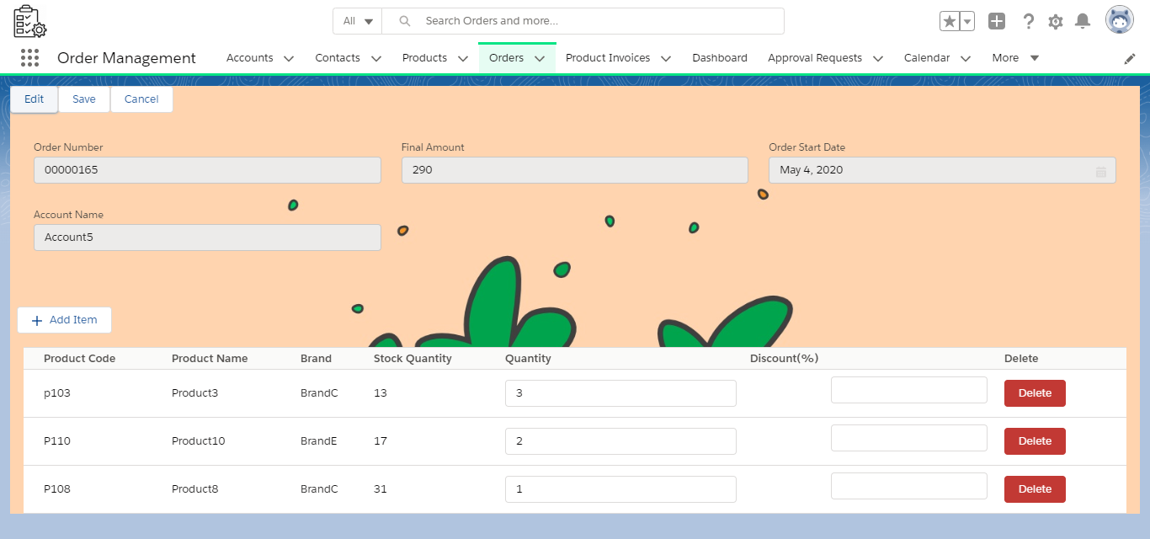
Edit Order Page

Slide 19
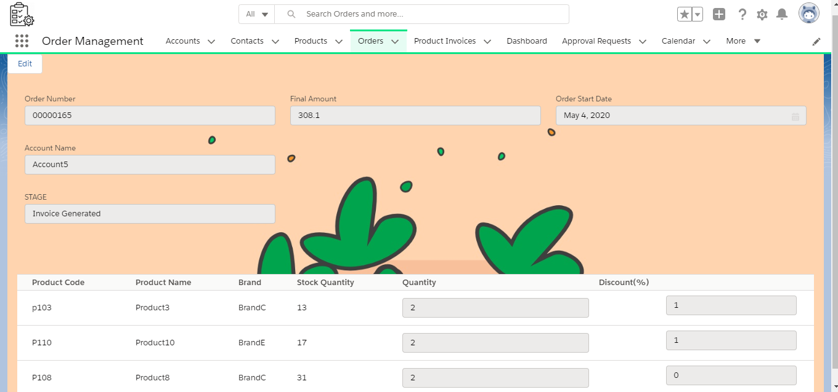
View Edited Order Page

Slide 20

ADMIN PART

Slide 21
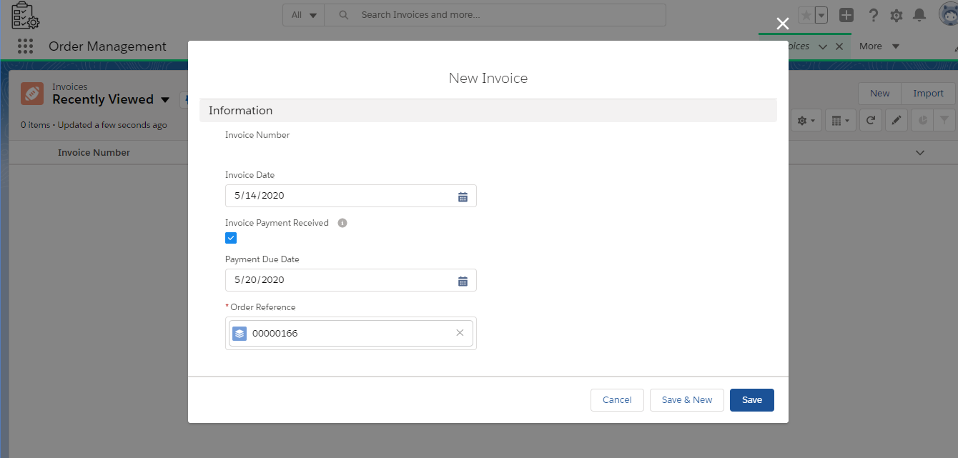
Invoice Creation

Slide 22
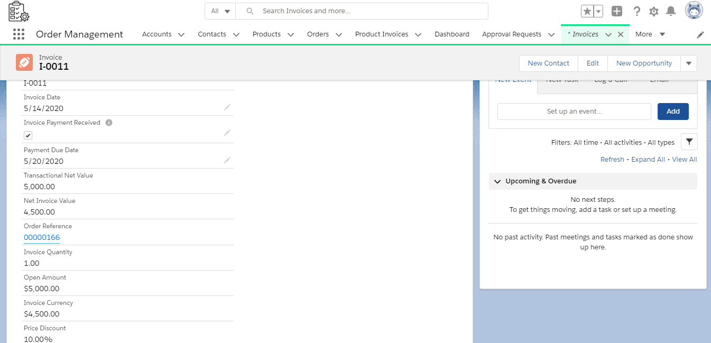
Invoice Auto Fields

Slide 23
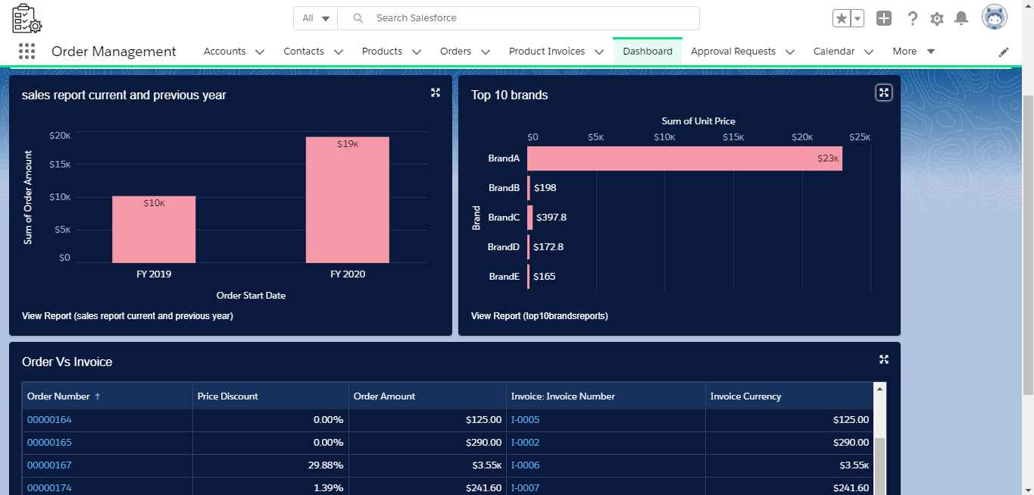
Dashboard For support team

Slide 24
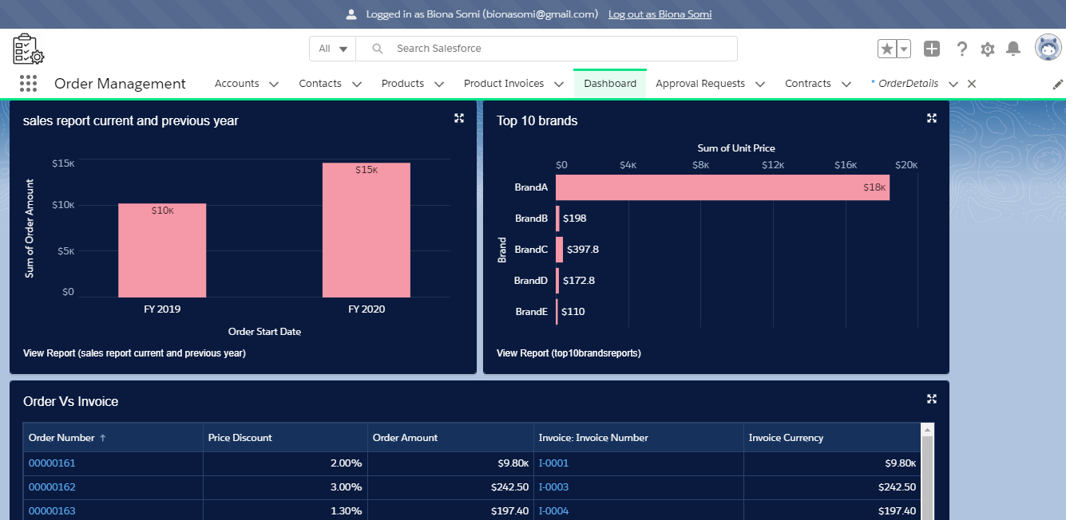
Dashboard For Business User

Slide 25
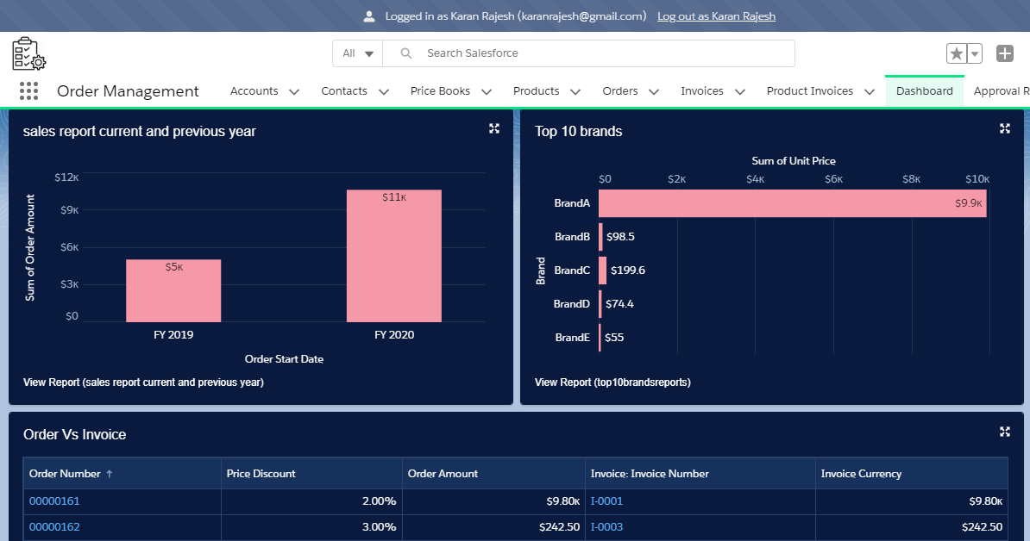
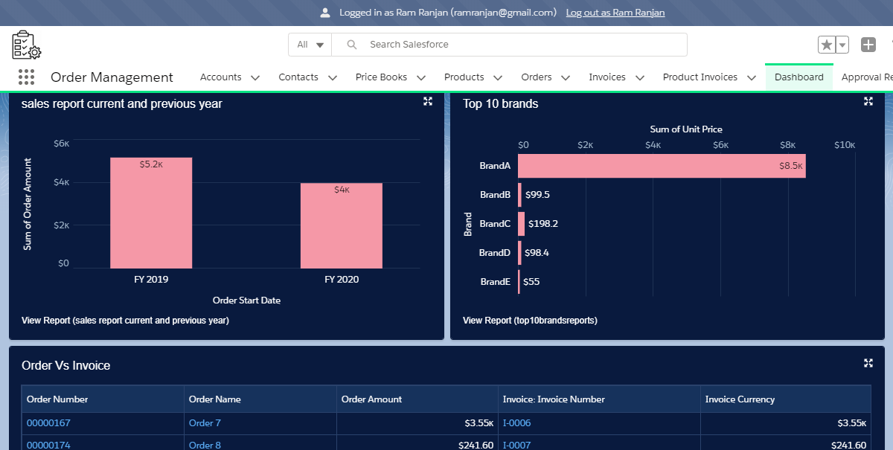
Dashboard For Sales Users
Sales User 1
Sales User 2

Slide 26
Process Builder & Validation Rules
Process Builder
Validation Rules
To send to approval by business user if amount is greater than $10000.
To send email to the sales user on stage change
To update the stage if payment received is checked in invoice record and update stage to “Delivery in Plan” after one day of receiving payment.
Process Builder for sending in app notification to business users and support team about stage update.
Order’s End Date can’t be less than order’s start date
Order’s stage can’t go back to the previous stage (INACTIVE)
Order remarks should be there if the stage is cancelled
Product stock quantity can not be less than 0
Invoice Start Date can’t be less than order start date.
Payment Due Date in Invoice should not be less than Invoice Start Date

Slide 27
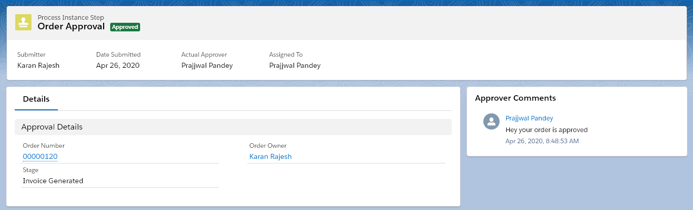
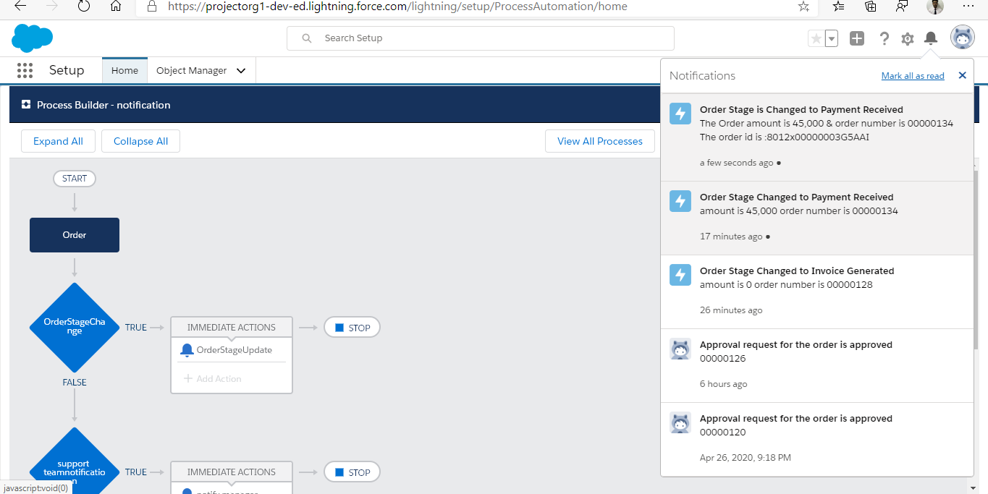
Approval If order Amount>100000
In app notification For
Business and support team on stage change

Slide 28
THANK YOU

